Slide 1
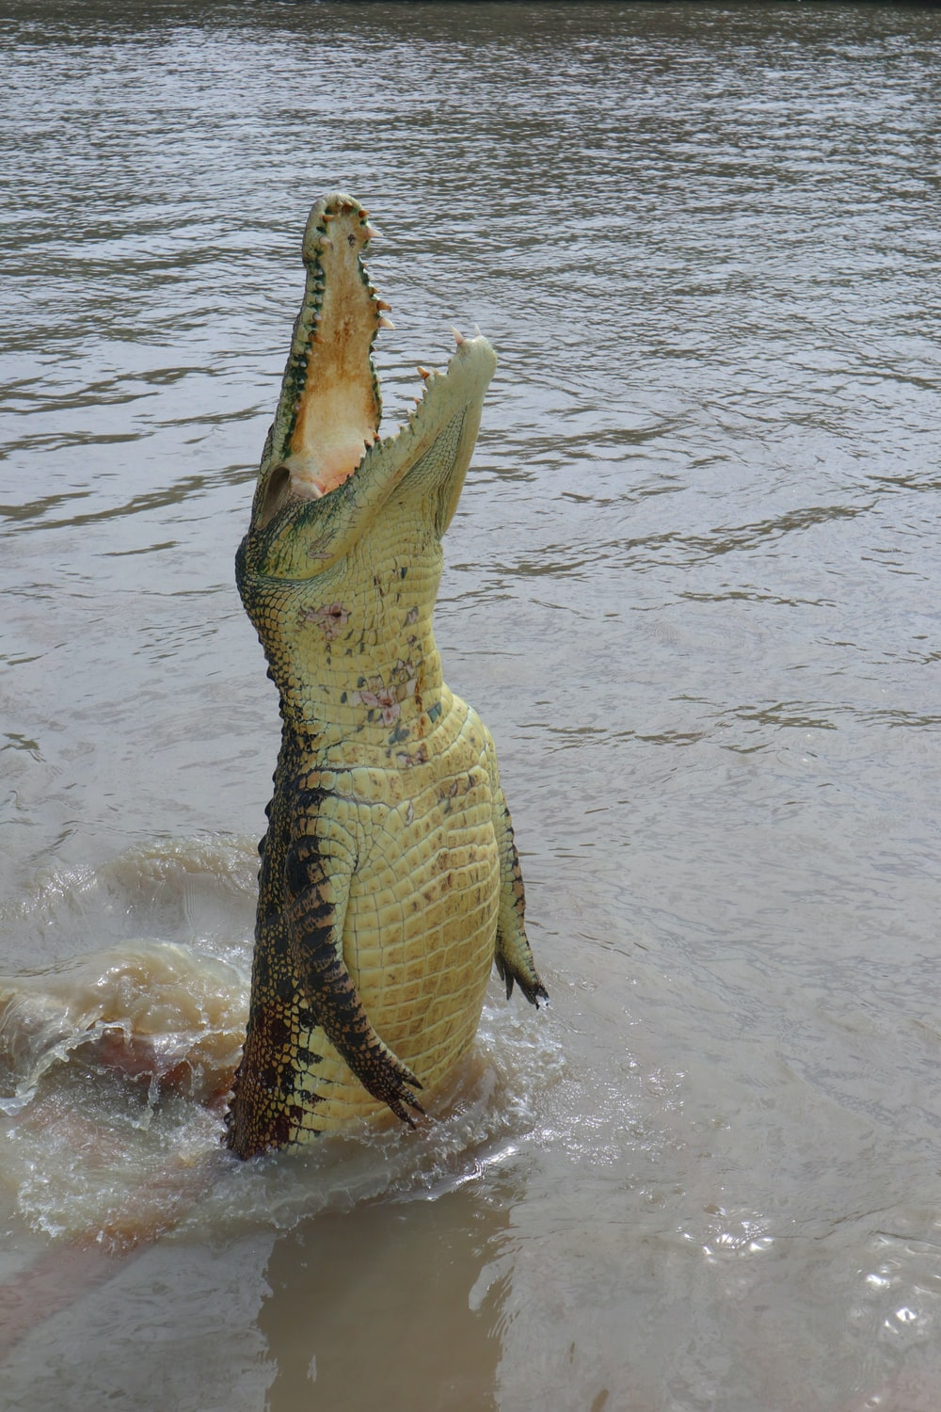

The dream: Best practice for data analysis in research and HE teaching
Ed Harris
2021-12-06
Harper Adams
'Supervisor Series'
Link for this talk ppt
https://bit.ly/31mYFNG

Slide 2

STATS
LEARNING

Slide 3
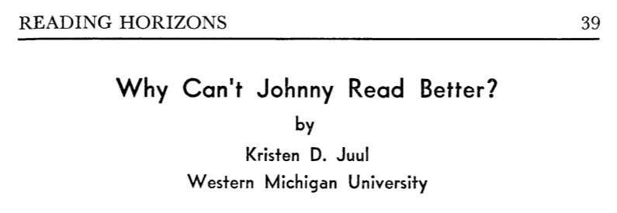
-We want a silver bullet (like, teachers: do better!)
-Overwhelming evidence suggests it's complicated
Juul 1961

Slide 4
Why can't Alice do a 2-way ANOVA?
-We want a silver bullet ...

Slide 5
Here is what (I think) we want for our students
(narrow view)
appropriate
statistical
literacy
domain-relevant
numeracy
Students enter
engaged and
prepared
data,
methods
project
productive member of society

Slide 6
Hierarchy of statistical literacy
Making sense of evidence
-Explain processes
-synthesize concepts
-interpret stats results
Design questions and evidence
-Choose appropriate methods
-Design data collection
-Evidence generation
Be a good citizen
in a data-laden society
-stats terms
-proportions, risk
-knowledge of stats language and tools
-being critical of evidence
Garfield and Ben-Zvi 2007

Slide 7
Factors influencing outcomes in statistical methods
teaching and learning
learner
-prior knowledge
-attitudes & beliefs
-goals
-experience
Course
-goals
-instruction
-assessment
-instructors
Institution
-faculty
-resources
Student outcomes
-learning
-persistence
-attitudes & beliefs
Garfield et al. 2000

Slide 8
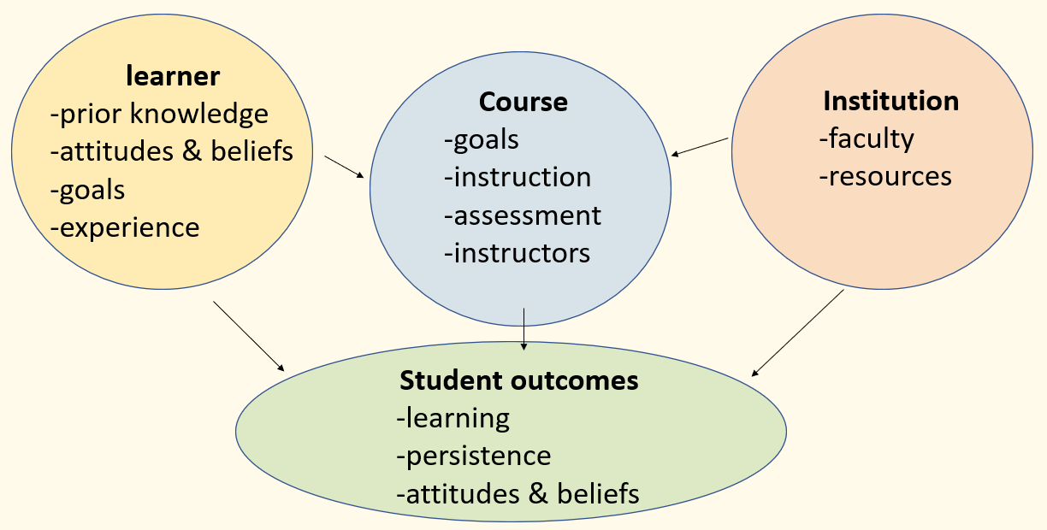
There are some challenges
NB
-a single stats module is a small part
-resources
-managing expectations
-project usually large part
-should reinforce numeracy

Slide 9
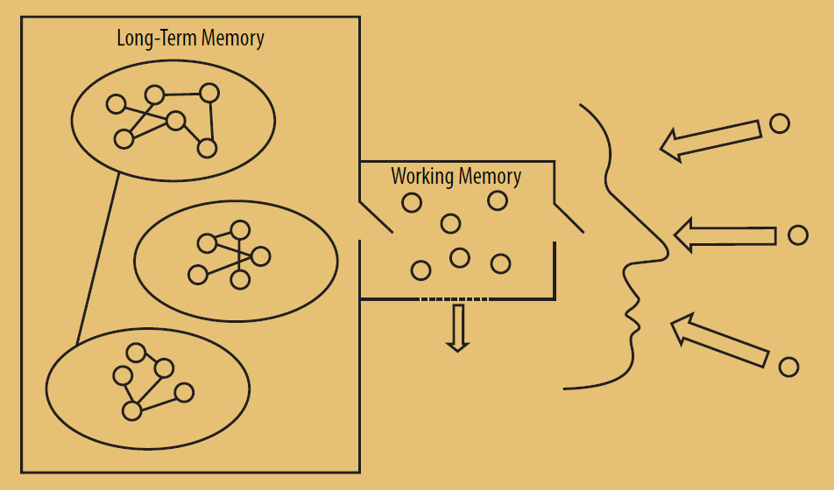
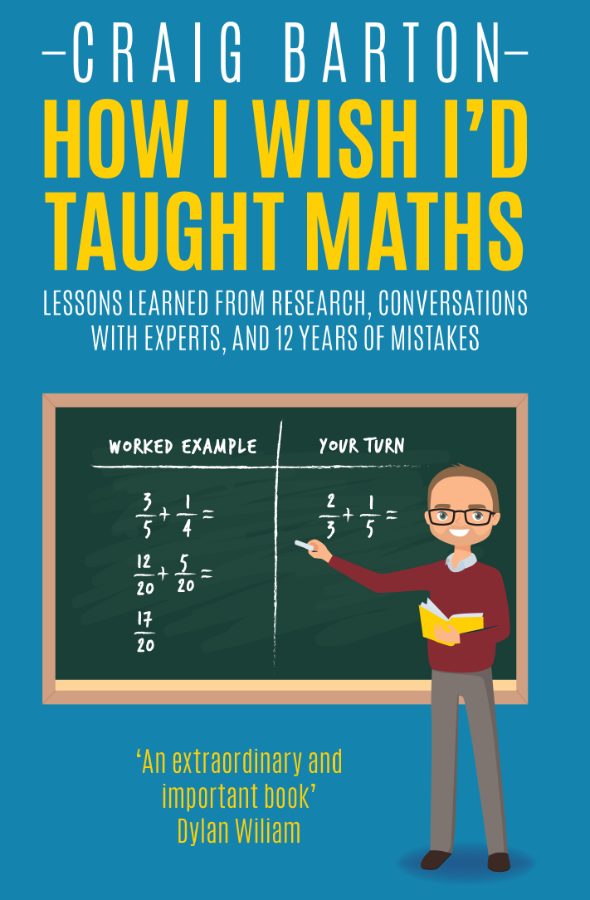
How do students learn?
Barton 2018

Slide 10
How do I want (my teaching)
to affect others?
1) My 'students' think about the right, relevant things
2) Learning is retained in long-term memory
3) It can be accessed and applied to new situations

Slide 11
learner
-prior knowledge
-attitudes & beliefs
STATS
LEARNING

Slide 12
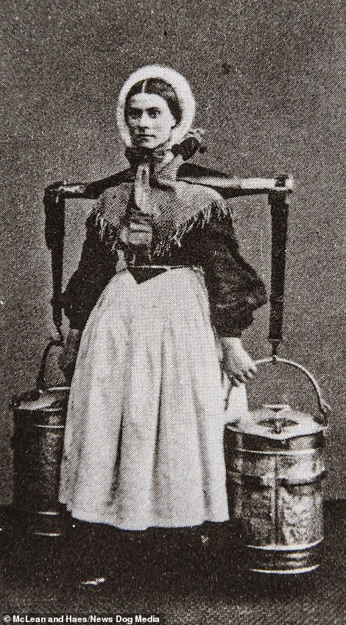
“I milk cows for a living. Why are you teaching me to do computer programming and statistics?”
This is a valuable skill
It may seem hard but it is worth it
You can do this and I've got your back
(Successfully suppressed: God, I wish I knew)
Moral: We must manage expectations and be kind

Slide 13
Tripartite view of curriculum
Eckstein et al. 1982

Slide 14
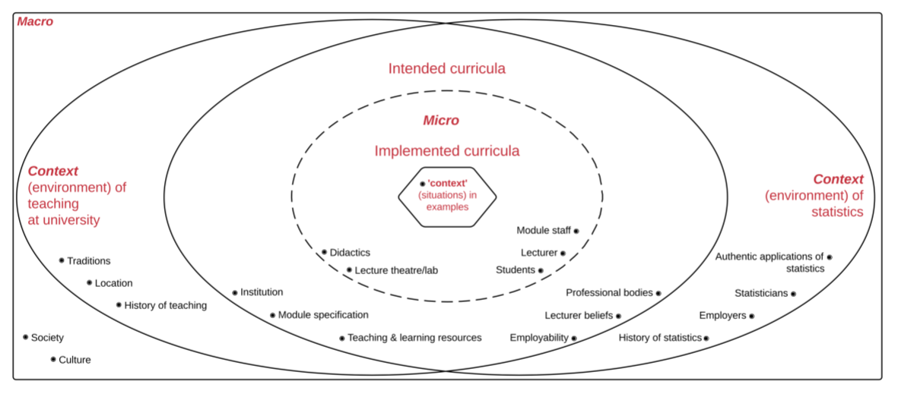
What we want versus what actually happens
Harth 2018

Slide 15
Teaching statistics is a special case in pedagogy
-non-majors concepts
-often taught by non-domain experts
-student domain knowledge greatly varies
-student attitude and belief greatly varies (often negative)
Yet
-foundational in many disciplines
-professional standards
-employability
Hulsizer & Woolf 2009

Slide 16
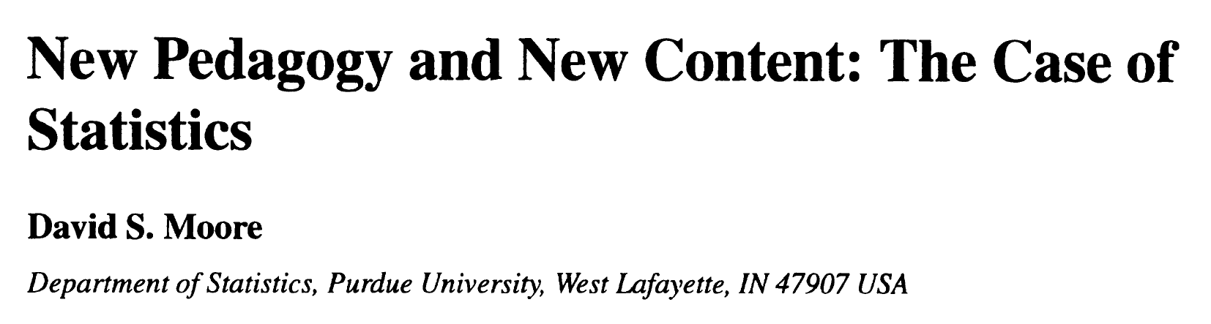


What does best practice look like?
-Statistical thinking (not memorization of equations)
-More real data (emphasize variation, subjectivitiy)
-Foster active learning (discussion, create data, present and debate)
Moore 1997

Slide 17
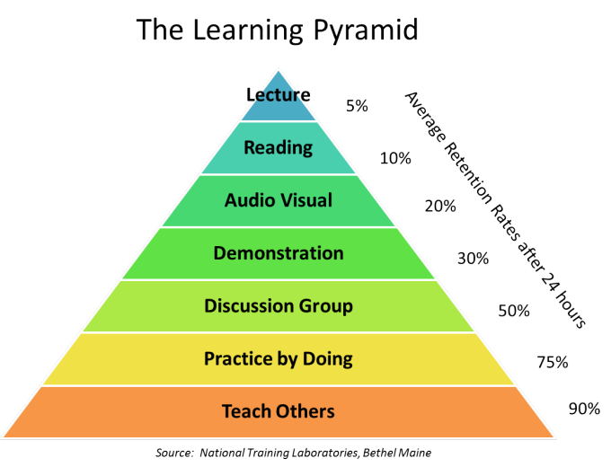
What does best practice look like?
I hear, I forget;
I see, I remember;
I do, I understand.
(old proverb)
Active learning
Rosenthal 2006

Slide 18
What does best practice look like?
Use open, scripted software for analysis (like R, SAS, Python) and store data in non-proprietary formats
-reproducibility
-collaboration
-.csv, Excel
Borer et al 2009

Slide 19
What does best practice look like?
Practice of tidy data + data dictionary
-rows are observations
-data dictionary
-no embedded stuff
Wickham 2014

Slide 20
Going beyond ANOVA, and using
-Fits best practice, free and open
-Most up to date stats software at present
-Huge, rising popularity
-Already common at BSc level
-Confers employability advantage
Also
-Easier to supervise (even if supervisor does not use R)
-Professional development for staff

Slide 21
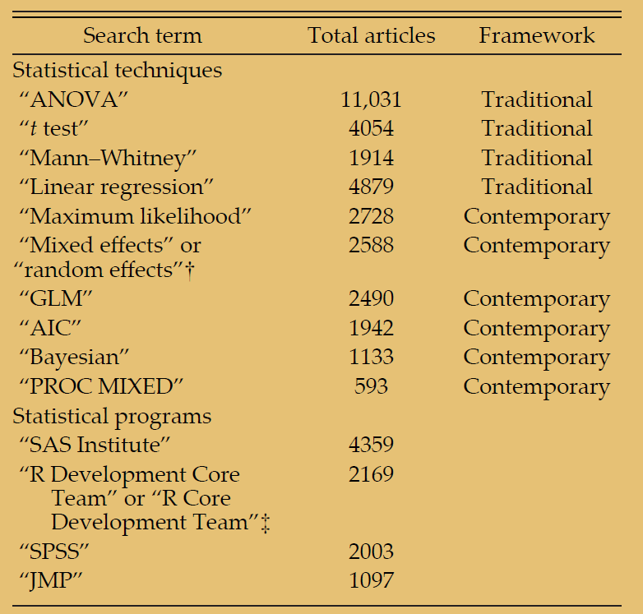
Stats techniques used in papers (since 1990)
Touchon & McCoy 2016

Slide 22
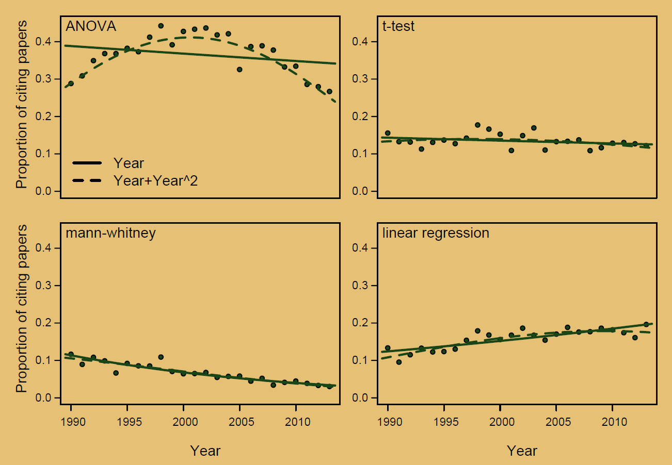
Stats techniques used in papers (since 1990)
'Traditional'
techniques
Touchon & McCoy 2016

Slide 23
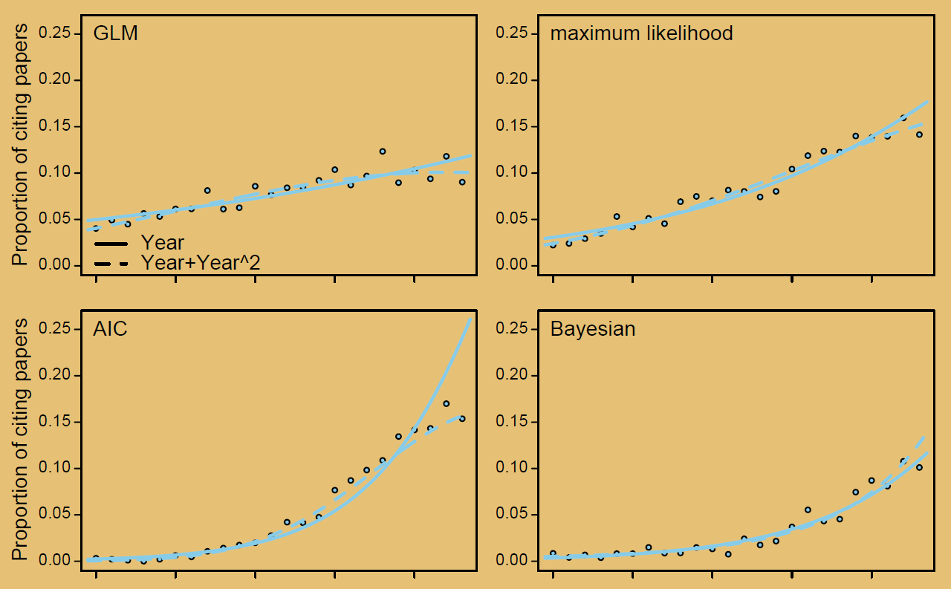
Stats techniques used in papers (since 1990)
'Modern'
techniques
Touchon & McCoy 2016

Slide 24
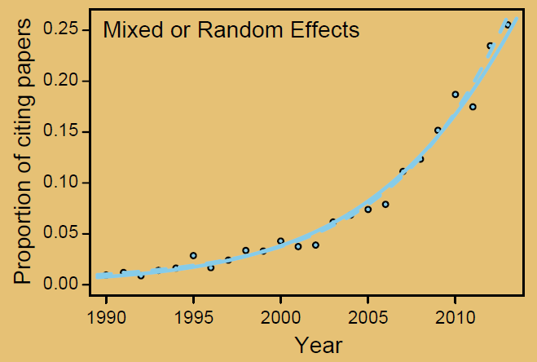
Stats techniques used in papers (since 1990)
'Modern'
techniques
Touchon & McCoy 2016

Slide 25
Stats software used in papers (since 1990)
Touchon & McCoy 2016

Slide 26
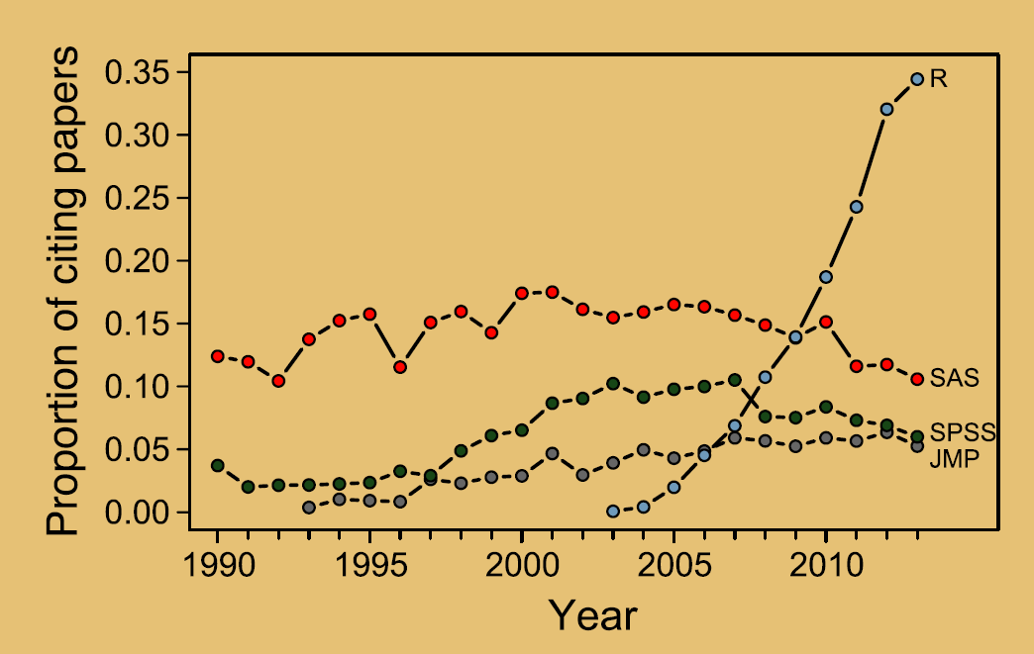
What stats software is cited in papers
Touchon & McCoy 2016

Slide 27
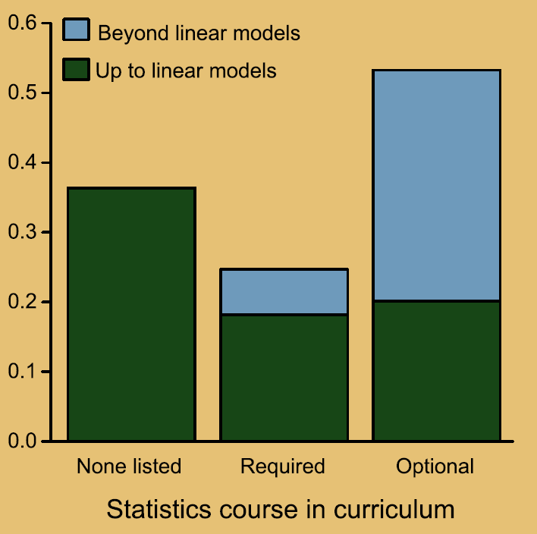
Training in research degrees
Touchon & McCoy 2016

Slide 28
Skills in job advertisements
% Job
advertisements
(in ecology)
mentioning
stats + R
Auker & Barthelmess 2020

Slide 29
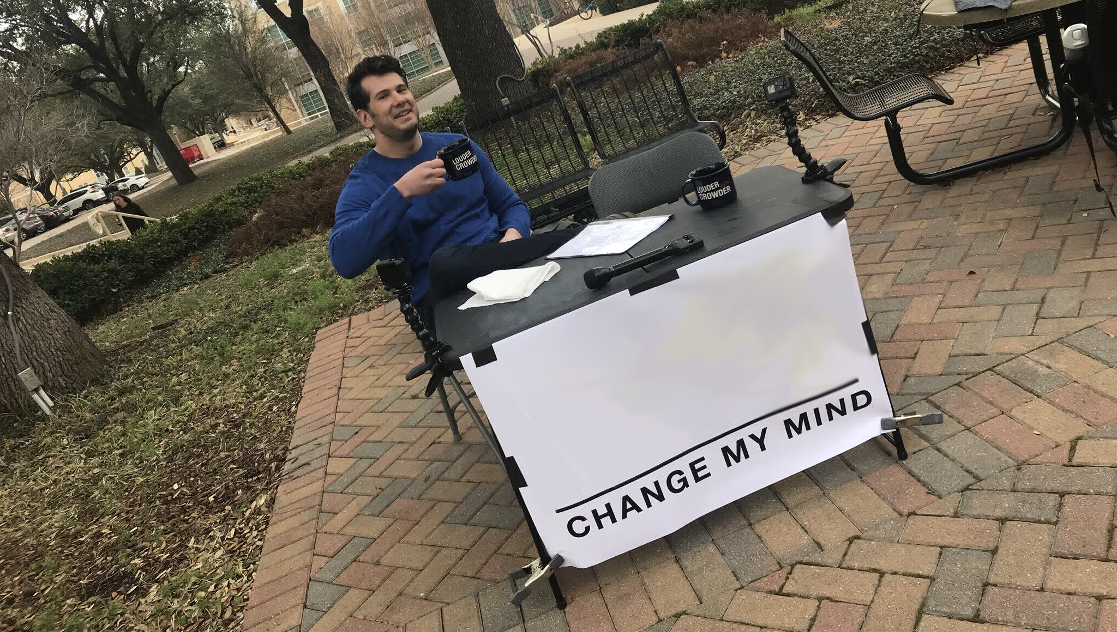
project supervision ==
collaboration

Slide 30


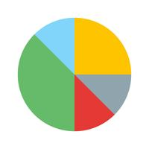



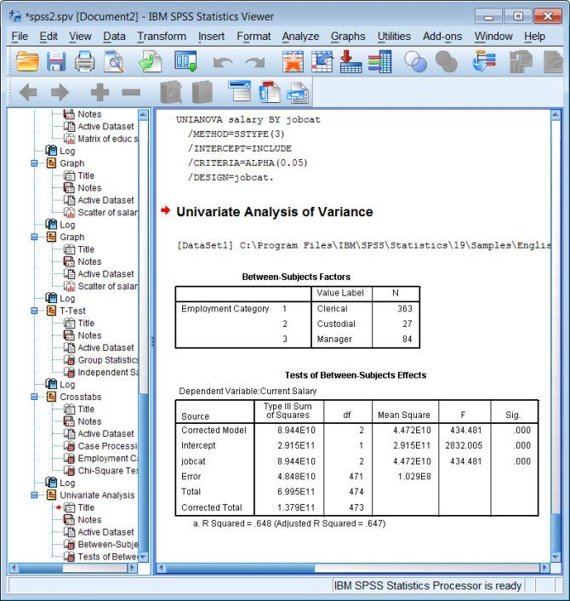

Two collaborative models
1
data 1
data 2
start with
data
fix data
stats software
stats outputs
report
2
data 1
+
+
tidy
data
report

Slide 31
Non-reproducible workflow
data 1
data 2
start with
data
fix data
stats software
stats outputs
report
-many students are not up to it ("SPSS is easier")
-report filters analysis - hard to give feedback
-recreating analysis after feedback is time consuming
-no record of analysis (and possibly data) after report turn-in

Slide 32
Non-reproducible workflow
data 1
+
+
start with
data
report
-Exact record of analysis and data handling
-Report update is potentially instant for large or small suggestions
-Students would already 'have the tools in their toolbox'
-Naive colaborators can reproduce, and learn while doing so

Slide 33
Also, what happens before here?
data 1
+
+
start with
data
report

Slide 34
Some resources
Friendly R Bootcamp
https://dsgarage.netlify.app/bootcamp/
HARUG! R group
https://ha-data-science.github.io/pages/harug.html
Slack for R and general stats support join link
(kindly use your full real name e.g. 'Florence Nightingale')
https://bit.ly/31yKN2C

Slide 35
References
Auker, L.A., Barthelmess, E.L., 2020. Teaching R in the undergraduate ecology classroom: approaches, lessons learned, and recommendations. Ecosphere 11, e03060. https://doi.org/10.1002/ecs2.3060
Borer, E.T., Seabloom, E.W., Jones, M.B., Schildhauer, M., 2009. Some Simple Guidelines for Effective Data Management. The Bulletin of the Ecological Society of America 90, 205–214. https://doi.org/10.1890/0012-9623-90.2.205
Eckstein, M.A., College, Q., Travers, K.J., Shafer, S.M., 1982. A Comparative Review of Curriculum: Mathematics and International Studies in the Secondary Schools of Five Countries. 114.
Garfield, J., Ben-Zvi, D., 2007. How Students Learn Statistics Revisited: A Current Review of Research on Teaching and Learning Statistics: How Students Learn Statistics Revisited. International Statistical Review 75, 372–396. https://doi.org/10.1111/j.1751-5823.2007.00029.x
Garfield, J., Hogg, B., Schau, C., Whittinghill, D., 2000. Best Practices in Introductory Statistics (Position paper prepared for the Undergraduate Statistics Education Initiative). American Statistics Association.
Harth, H., 2018. An analysis of the teaching of introductory statistics at university in “context” (PhD). University of Loughborough.
Juul, K.D., 1961. Why Can’t Johnny Read Better? 6.
Moore, D.S., 1997. New Pedagogy and New Content: The Case of Statistics. International Statistical Review 65, 123–137. https://doi.org/10.1111/j.1751-5823.1997.tb00390.x
Rosenthal, J.S., 1995. Active learning strategies in advanced mathematics classes. Studies in Higher Education 20, 223–228. https://doi.org/10.1080/03075079512331381723
Touchon, J.C., McCoy, M.W., 2016. The mismatch between current statistical practice and doctoral training in ecology. Ecosphere 7, e01394. https://doi.org/10.1002/ecs2.1394
Wickham, H., 2014. Tidy Data. Journal of Statistical Software 59, 1–23. https://doi.org/10.18637/jss.v059.i10

